Slide 1
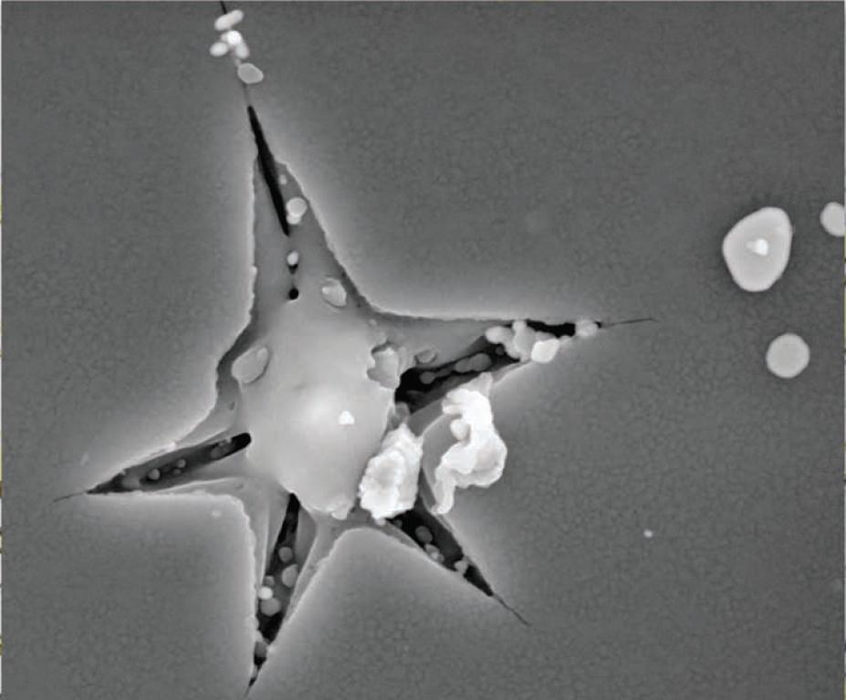
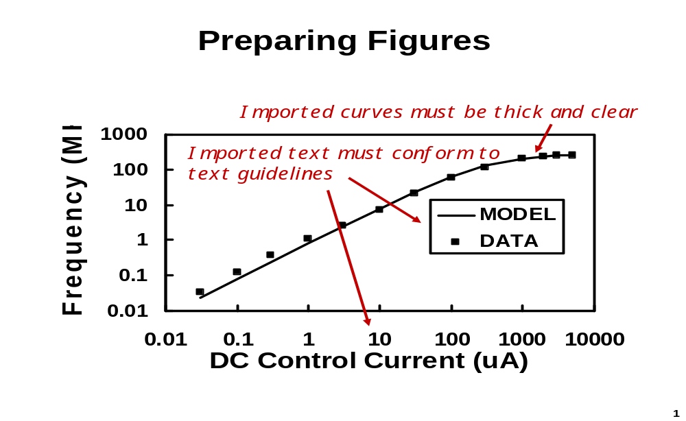
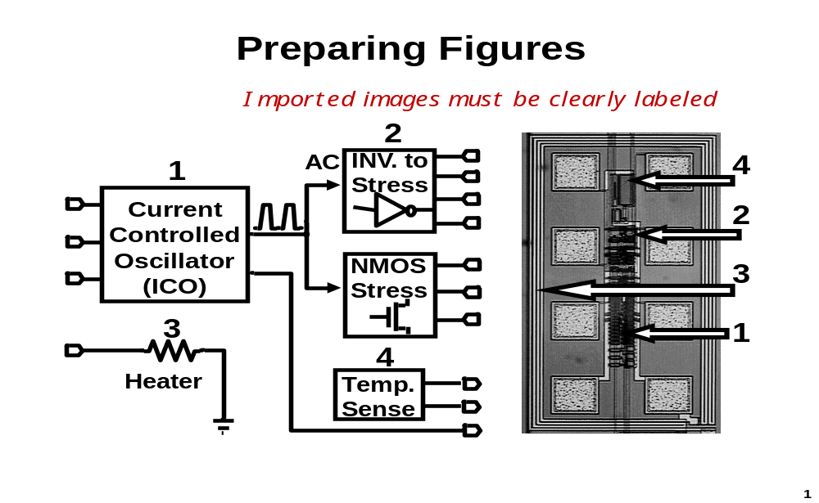
ASMC Technical Poster Template—Title of Presentation
Area to insert/place
logo(s) of
organization(s)
Author(s)
Company Name
Introduction/Abstract
Brief overview and description of the topic covered.
Include objective. Spell out/define abbreviations.
    Bullet Points
    Bullet Points
Data/Materials
Add key, relevant data. Images/graphs will help your audience understand the technical information as you walk through the presentation. Color is helpful, though
no required. See samples below.
Results/Findings
What are the key results?
Conclusion
What is the key takeaway from the results?
What can one conclude from the findings?
References
Technical publication(s)
Contact Information
Author contact email and/or URL/link
Background
Add background info needed to describe your paper/
approach/data.
Feel free to be creative with the space, while adhering
to overall guidelines and size restrictions.
Available size of
Posterboard/Frame
is 8' x 4' (2.4m x 1.2m)
Your poster should be minimum
48" x 36" (1.2m x 1Other than the m) or larger
to fit within the frame

